Slide 1
TITAINIC DATASET
SUB= INTRODUCTION TO PROBLEM SLOVING
NAME= Sumit Verma
REG NO = 25MIP1OO87

Slide 2
INTROUCTION
The Titanic survival dataset is one of the most popular dataset in data
science. It contains information about passengers on the Titanic ship, such
as their, age ,gender , ticket class, fare and most importantly. Whether
they survived or not.
The aim of the project is to --
Upload the dataset(in csv format) to Google Colab
Extract the file
Load the CSV dataset
Explore basic dataset information
Perform basic analysis
Calculate the survival count

Slide 3
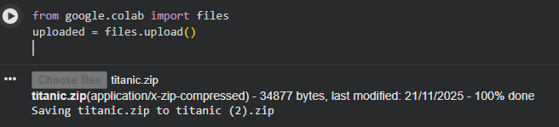
DATA UPLOAD
First , we have to download the dataset. After that, we will write a
code to upload the file in Google colab.

Slide 4
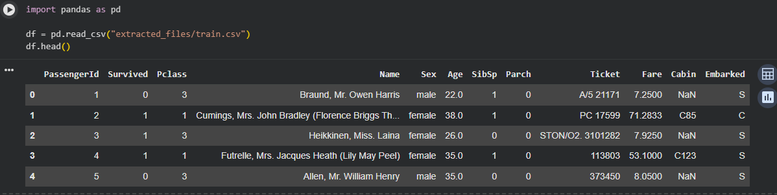
LOAD &VIEW DATA
This command is used in Python to load the data form the file that we have uploaded.

Slide 5
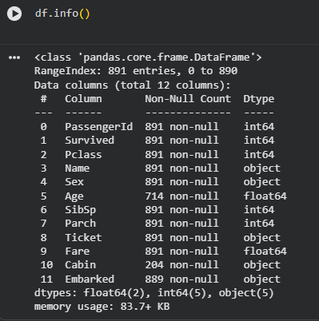
BASIC DATASET column types refer to the kind of data stored in each column are the empty or undefined entries in a dataset.

Slide 6
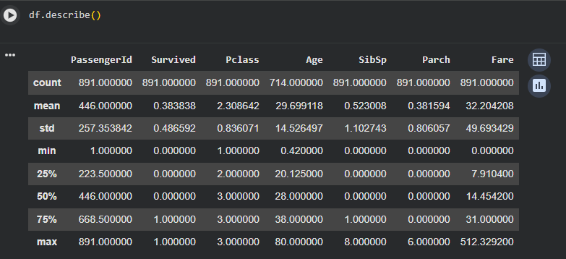
STATISTICAL SUMMARY The describe()function is used to generate a statistical summary of the dataset .It provides important information such as the mean, minimum value, maximum value, standard deviation , and quartiles for each numerical column. This helps us understand the overall distribution and basic characteristics of data.

Slide 7
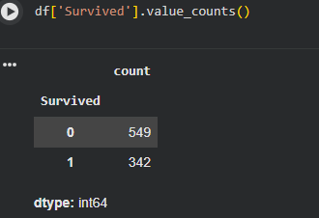
Survival count To check how many passengers survived:

Slide 8
Summary
In this project , the Titanic Survival dataset was uploaded, extracted, loaded , and explored. We examined dataset information. Performed descriptive statistical analysis, and computed the survival count. This project provides a simple and effective introduction to data analysis using python.

